Slide 1


Enhanced Multi-label Deep Neural Network Model for Risk Prediction Diabetes Complication
Raden Nur Rachman Dzakiyullah (P031710017)
Supervisors:
Prof. Dr. Burhanuddin Mohd. Aboobaider
Dr. Raja Rina Binti Raja Ikram
Progress Report
16 August 2023
Panel: 1. DR ABDUL SYUKOR BIN MOHAMAD JAYA
2. PM. TS. DR. CHOO YUN HUOY
Notes:
Assalamualaikum Wr. Wb, Good Afternoon. Before I begin, First of All, I would like to say thank you very much for giving me opportunities to presenting my research with entitle “An Improved Deep Neural Network Model for Risk Prediction Diabetes Complication”. My name Nur Rachman Dzakiyullah

Slide 2
Contents
Research Background , Motivation and Literature Study
Relation on Research Problem, Research Question and Objective, Research Contribution
Research Methodology
Experimental Design
Conclusion
Notes:
This presentation consists of 7 outlines that begin with background. Followed by Research Problem Research Question and objective, and so on. And The last but not least is conclusion

Slide 3
Research Background and Literature Study

Slide 4
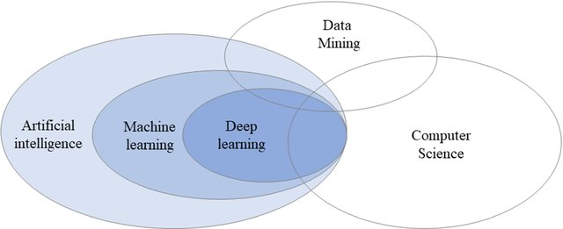
Research Background
The target variable is typically a single continuous or discrete variable, corresponding to the two common tasks of regression and classification, respectively. However, in practically relevant problems, more and more often, there are multiple properties of interest, i.e., target variables (Jasmin Bogatinovski, et. al., 2021).
Esfandiari et al., 2014 stated that a new perspective in interdisciplinary contribution of medicine and data mining is called medical data mining. In this context, “Prediction classification” effectively used in medical and healthcare domain, for example, in context diabetes research, the needs of Knowledge extraction which is relations between variables, identifying risk factors and exploring novel knowledge.
Kavakiotis et al. 2017; Toshita and Shah, (2021); Luis Fregoso‑Aparicio, (2021) studies by reviewing applications of machine learning and data mining techniques in the field of diabetes research was successfully apply to solve early diagnosis, prognosis and treatment of diabetes.
Artificial Intelligent (AI) are more advanced, since the improvement of several machine learning algorithm, especially Deep Learning (DL) algorithm. Deep learning is a new research direction in the field of machine learning and in recent years, it has achieved breakthrough progress in many application (Zhou et al., 2020).
Venn diagram representing the relationships between AI, ML and DL
(Wengang Zhang et. Al. 2021)
Notes:
In TRADITIONAL supervised learning is one of the mostly- studied machine learning paradigms, where each real-world object (example) is represented by a single instance (feature vector) and associated with a single label

Slide 5
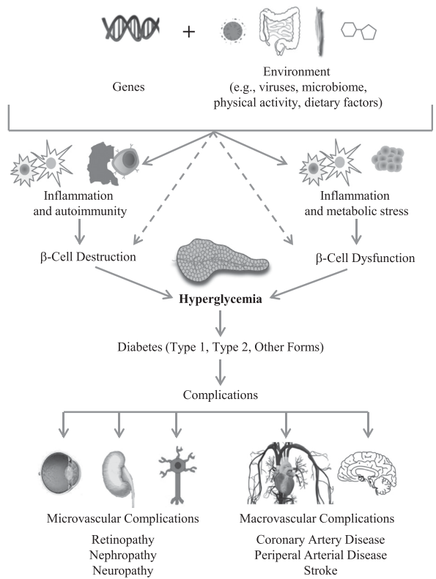
Motivation on this study and Research Position
According to (Vu et al., 2020) several topics found in the application of AI with diabetes becoming top areas of interest and increase dramatically in publications. They stated that there are five major emerging research domains:
AI application in diabetes prediction and diagnosis;
complications of diabetes prediction;
biomedicine and molecular biology in diabetes;
e-health for diabetes care, and
robot-assisted surgery for patients with diabetes.
In diabetic research. Risk Prediction is a risk factor or risk assessment model consists of any type algorithm or mathematical formulation that modeled as a core of clinical/medical application that able to measure diabetes patients by understanding their probability of developing a complication that can be happen in the future (Lagani et al., 2013, 2015).
The risk prediction model can be built based on a small or large dataset that has been collected from a clinical patient record or electronic health record or questionnaire trough patient, then, the prediction can be performed.
According to Xie et al., (2019) was building a prediction model for T2DM using The Behavioral Risk Factor Surveillance System (BRFSS) dataset and the recommendation for further studies in predictive modeling using survey data need to be further identified, and other risk factors need to be recognized.
However, in many real life problems of predictive modelling the output (i.e., the target) can be structured, meaning that there can be more complex output structures such as vectors of variables with some dependencies among them.

Slide 6
Risk Prediction Diabetes Complication Problems (1)
Multi Label Classification Problem
Related with Data problem:
label dependencies
high dimensional multi-label space.
Imbalance Dataset
Noisy Dataset
Outlier Dataset
Diabetes Complication in a domain problem then transform into Multi Label Classification Problem
Typical classification algorithms perform best when the distribution of data in each of the binary classes is equally distributed. However, when dealing with a high volume of data, especially in the multi-label context, class imbalance is a typical side effect, since not all the labels may be evenly distributed across data instances.
6
Notes:
Since there exist multiple targets to predict, the task of MLC is more difficult than binary classification [2]. While in binary classification the complexity of the models depends on the number of relevant features and number of samples the MLC task has an additional complexity along the target dimension. These issues present specific challenges for and influence the development of methods for MLC: label dependencies and high dimensional multi-label space.

Slide 7
Risk Prediction Diabetes Complication Problems (2)
Why Deep Neural Network Model?
Along with the increasing popularity of deep learning, it has become a trend to use deep learning to solve multi-label tasks. (Peng, et. al., 2021)
DNN Has ability Non linier approximation and strong capability in learning multiple label.
In this study we, conducting DNN because the structure of Fully connected is more suitable the case of Diabetes Complication that can handle multi label task classifications.
Deep Neural Network Model Problem
In Handle MLC problem especially Real-world data with high-dimensional feature space, The Performance of DNN model has extended computational times, higher memory requirements, and slow down the classification performance (Ibrahim et al., 2021).
DNNs are easy to overfit the label noise in the dataset, and thus achieve poor generalization performance. Training using DNNs reliably on datasets with corrupted labels remains challenging (Wang, Yulin 2020). However, this assumption can be dangerous in imbalanced classification problems such as medical diagnosis, fraud detection, and access control systems.
7
Notes:
Imbalance Problem, Data of some classes are abundant, making them an overrepresented majority, and data of other classes are unusual, making them an underrepresented minority. This imbalance makes it challenging for a classifier to appropriately learn the discriminating boundaries of the majority and minority classes.

Slide 8
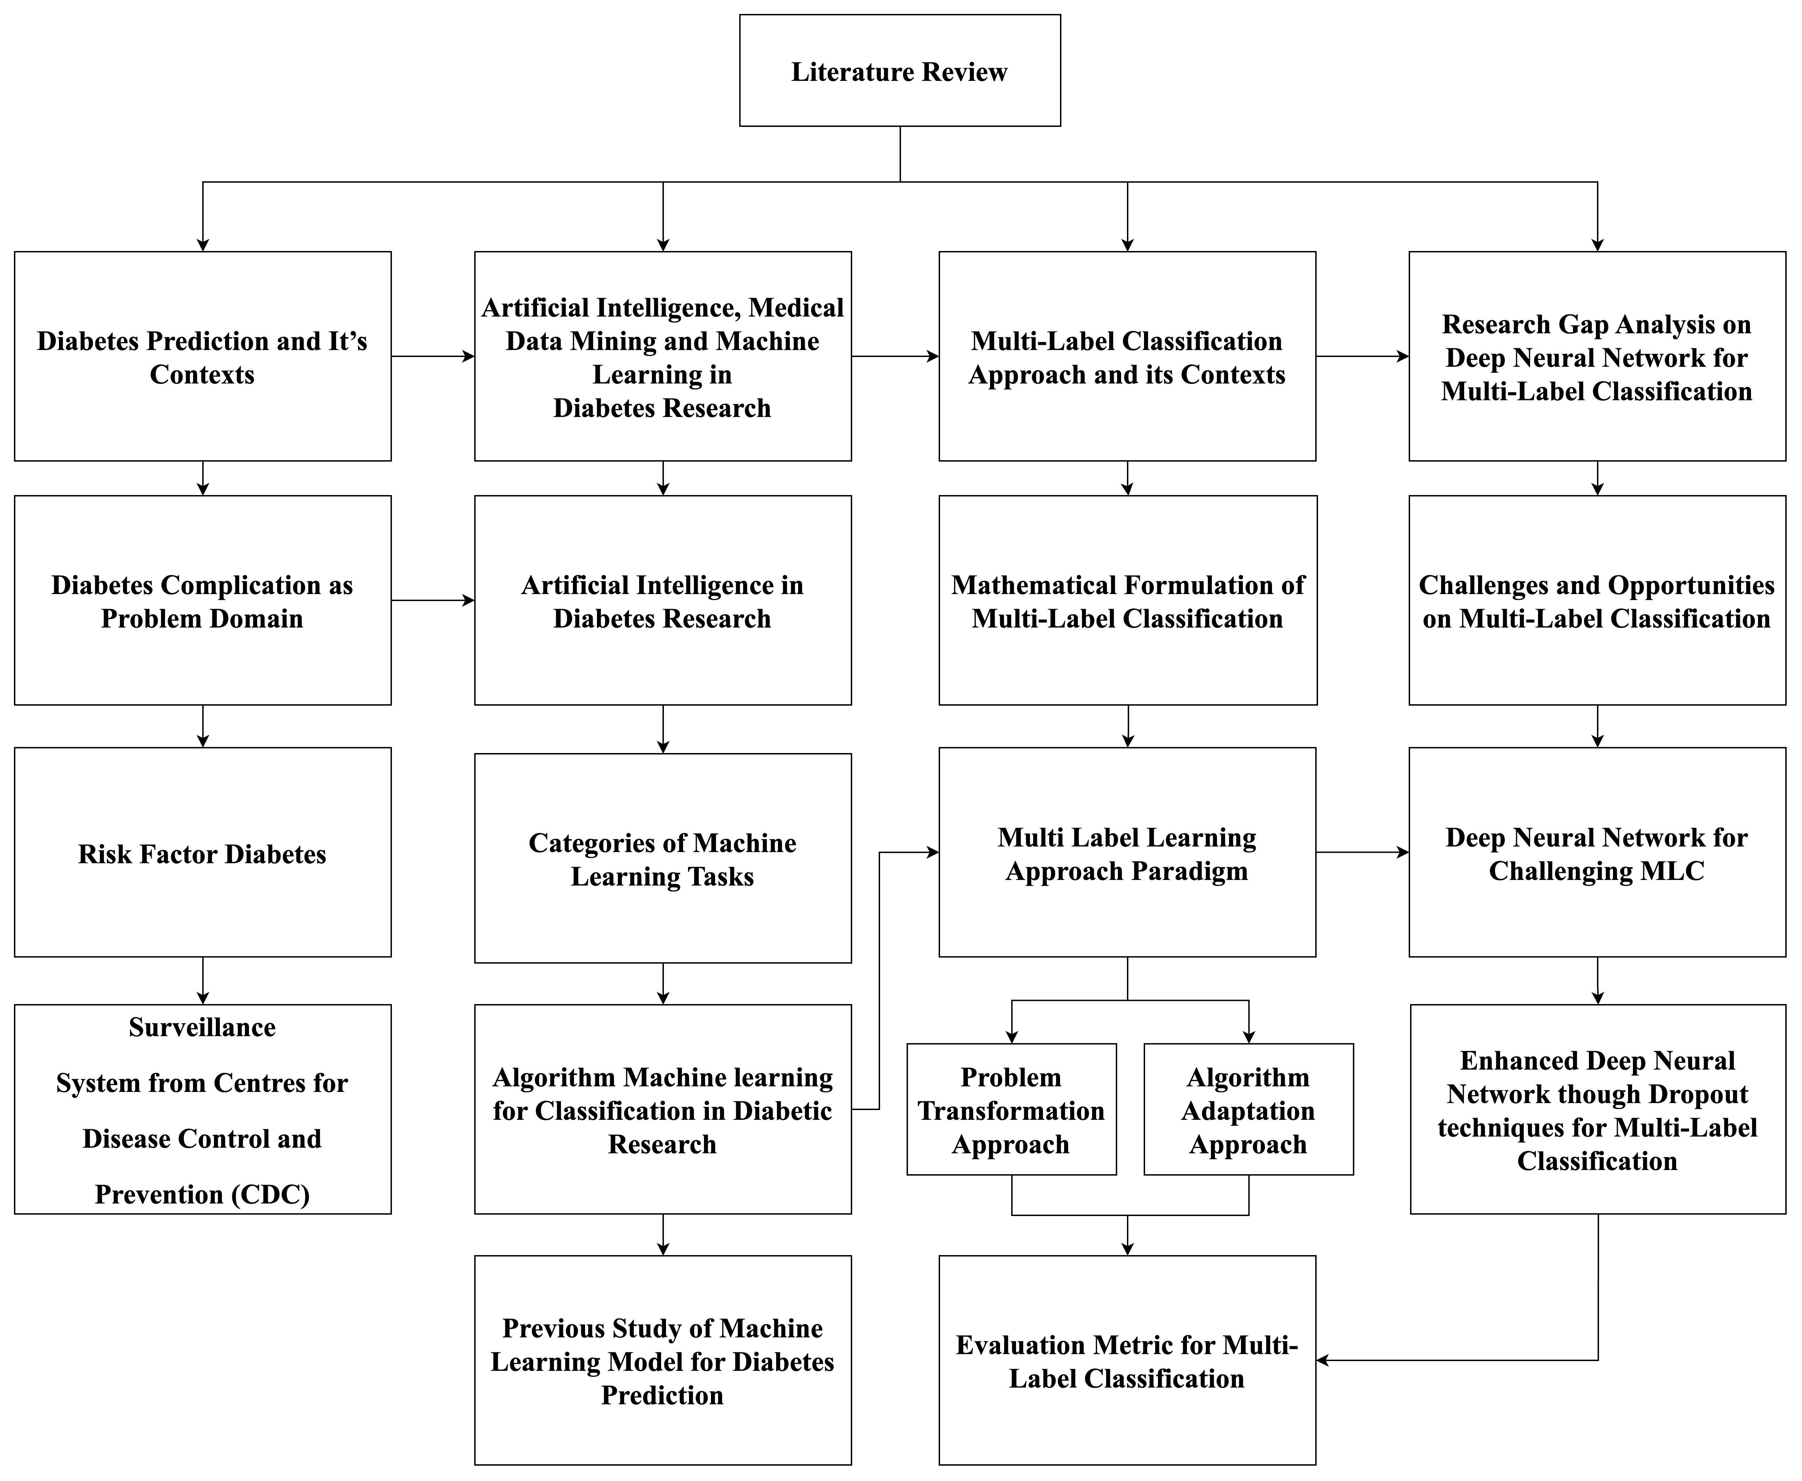

Literature Review Maps

Slide 9
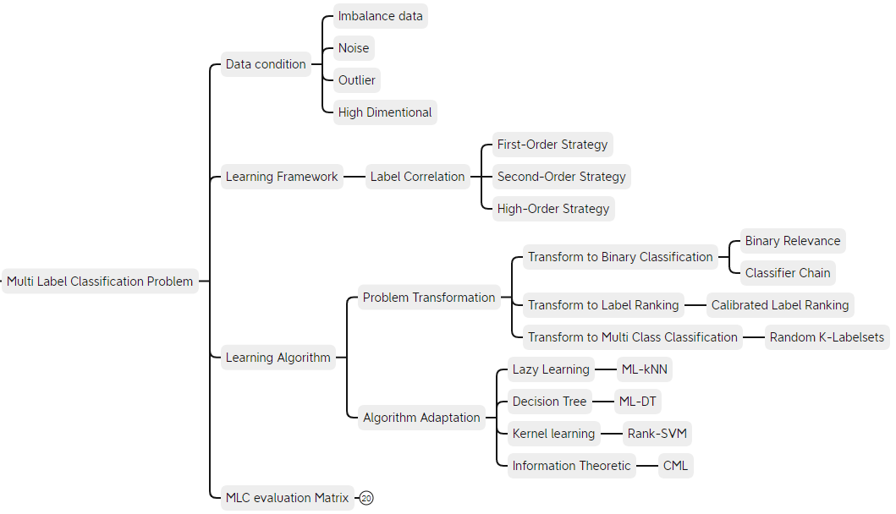
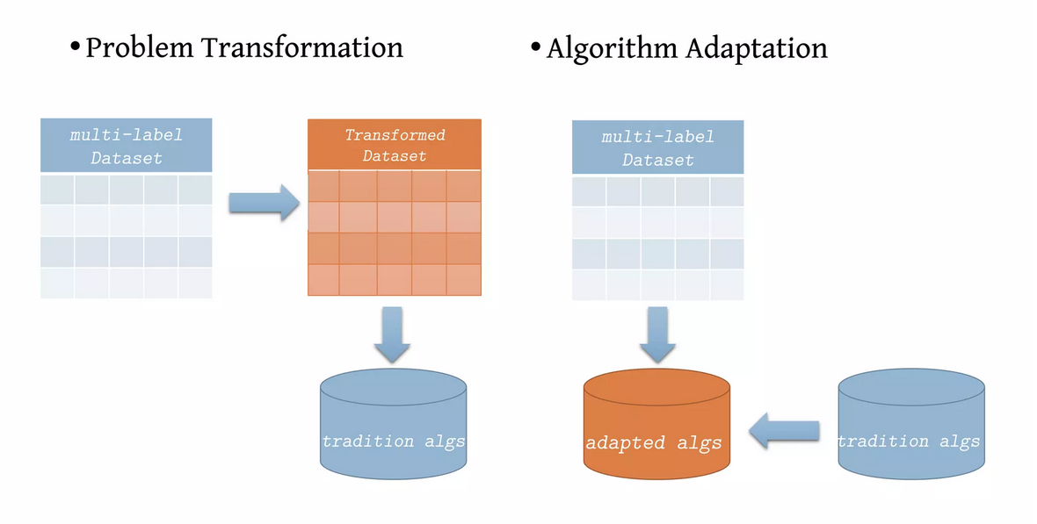
Problem Transformation Approached for MLC Problems
1) Problem transformation methods aim to transform and decompose the multi-label learning problem into one or many single-label classification tasks, followed by a re-transformation of the outputs into a multi-label representation. The key idea of problem transformation methods is to fit the data to the well-represented set of existing algorithms. This methodology can be further grouped into three use-case specific categories based on the kind of transformation required— binary relevance, label ranking, and multi-class classification.
(Jalodia, Taneja and Davy, 2021)
Notes:
Problem Transformation cannot be used for imbalance data.

Slide 10
Algorithm Adaptation Approached for MLC Problems
2) Algorithm adaptation methods, on the other hand, aim to directly tackle the multi-label learning task by adapting or extending the existing classification algorithms to work with multi-label data directly. Unlike problem transformation methods, the key idea of algorithm adaptation is thus to fit or extend an algorithm to work with a multi-label data representation.
(Jalodia, Taneja and Davy, 2021)
Notes:
Problem Transformation cannot be used for imbalance data.

Slide 11

Research GAP 1
When, the Risk Prediction Model was designed based on data. Correct and valid data for training the model is needed to ensure the quality prediction classification. In the perspective on healthcare data, is compulsory that the diagnosis of patient are correct.
Diabetes complication is specific problem from the context of domain healthcare. In the nature of data, Machine Learning cannot know that is corrected data or not. It’s need knowledge from the domain itself to justify. Therefore, its need data pre-processing strategy
Class Imbalance in Multi-Label Classification can decrease accuracy. When it comes to dealing with label imbalance in the multi-label domain, there are two generally accepted approaches. In one case, the model is adapted to minimize the impact of the imbalance, and, in the other case, the dataset is adjusted to minimize the labeling skew (Sommer, 2021).

Slide 12

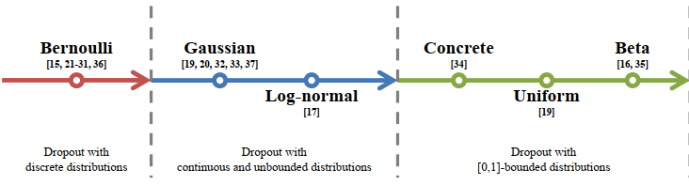
Research GAP 2
The model DNN has many parameters that can be used to increase performance in prediction classification. One importance parameters in the DNN model is Dropout Techniques. There is several Dropout Techniques that has been proposed by several researcher. Hinton 2012, was firstly introduce this method.
However, this parameters is difficult to adaptive in the training. One research gap is the lack of understanding of how to choose the optimal dropout rate for a given network architecture and dataset.

Slide 13

Relationship of Research Problem, Research Questions, Research Objective, Research Contribution

Slide 14
Research Problem 1 and Literature Support (1)
Research Problems |  | Literature Support
RP1 | The real word public data in the context diabetes complication can containing variables or features with imbalance and noisy that will affect performance of deep neural network model in the Multi label task classification (MLC) for Risk Prediction Diabetes Complication (RPDC). | Nnamoko and Korkontzelos (2020) stated that a balanced dataset is quite rare in real-world scenarios and learning from the outliers with imbalanced data is difficulty for classifiers in which can affect higher misclassification costs. Real world Diabetes dataset have an imbalanced class in nature. Noisy Attribute or redundancies, inconsistencies and missing value usually happen in some raw data (Varma et al., 2014; Ramírez-Gallego et al., 2017) Learning from imbalanced datasets is difficult. Dagliati et al., (2018) mentions the significant relationship between unbalance class problem with accuracy was heavily influenced when the original unbalanced data are used. By eliminating missing values, noisy data (data cleaning) and class imbalance will achieve effective feature for perform better pre-processing that effect accuracy of the model (Sudha, 2017). Lack of study for early detection and prognosis of diabetes complication. Many predictive models have been built and many risk factors have been identified for type 2 diabetes (binary classification). However, previous predictive models based on survey data need to be further improved, and other risk factors need to be identified (Xie et al., 2019).

Slide 15
Research Problem 2 and Literature Support (2)
Research Problems |  | Literature Support
RP2 | Difficulty in determining topology architecture and parameters of deep neural network model in the Multi label task classification (MLC) will affect Performance for Risk Prediction Diabetes Complication (RPDC). | Major challenges such as parameter settings for learning deep neural networks and construction of deep learning architectures still exist. The implications of those challenges have a significant impact on how a deep neural network is going to perform on a specific task (Vrbančič et. al., 2019). Deep Neural network (NN) has ability strong fault tolerance and nonlinear dynamic processing of fault data, but practicability of DNN is limited due to difficulty of selecting appropriate parameters of network architecture (number of hidden layers, number of nodes per layer). (Wahono, et. Al., 2014) Rule of thumb or “trial and error” methods are used to determine the parameter settings for deep neural network architectures. However, it is difficult to obtain the optimal parameter settings for deep neural network architectures. Unfortunately, there is no definite procedure to calculate these hyperparameter values (Zheng, et al., 2019). Building an appropriate DL model is a challenging task, due to the dynamic nature and variations in real-world problems and data. Moreover, the lack of core understanding turns DL methods into black-box machines that hamper development at the standard level. Settings of parameters are one of the crucial tasks to be performed. The parameters considered in deep and machine learning are model parameters and hyper-parameters. Model parameters concerned with the internal parameters used by the network, such as the weights, neurons, while Hyper-parameters deal with external parameter settings such as the learning rate, momentum, epochs, activation function, dropout, number of hidden layers, optimizer, to mention a few. Hyper-parameters are used to decide the structure, functions, accuracy, and validity of the network (Elujide et al., 2021; Dong et al., 2021). The commonly used methods to determine the optimal settings of fine-tuning hyper parameters are trial and error, grid search (brute force), Bayesian optimization, and random search (Elujide et al., 2021).

Slide 16
Research Problem 3 and Literature Support (3)
Research Problems |  | Literature Support
RP3 | Difficulty in dealing with overfitting problem during training of DNN model in the Multi label task classification (MLC) when the topology architecture model adding more layers and it found that when the hidden layer is more than two. | There is a chance of occurring overfitting problem that need to be dealt with. When the model adding more layers and it found that when the hidden layer is more than two, the overfitting problem occurs. (Rahman et al., 202; Zhou et al., 2020). Most of the existing methods are applicable only for a single-label multiclass classification problem, where each data example is assumed to have only one true label. However, in the case of multilabel learning, each data example can be associated with a set of multiple true class labels (Hwanjun Song et. al., 2022). DNNs easily overfit false labels owing to their high capacity in totally memorizing all noisy training samples. This overfitting issue still remains even with various conventional regularization techniques, such as dropout and batch normalization, thereby significantly decreasing their generalization performance. Even worse, in real-world applications, the difficulty in labeling renders the overfitting issue more severe. Therefore, learning from noisy labels has recently become one of the most active research topics (Hwanjun Song et. al., 2022). Data overfitting is a performance-degrading issue in diabetes prognosis. (Ashiquzzaman, 2018) Drop out problem…
Notes:
In the case of neural networks, the complexity can be varied by changing the number of adaptive parameters in the network. This is called structural stabilization. The second principal approach to controlling the complexity of a model is through the use of regularization which involves the addition of a penalty term to the error function.

Slide 17
Relation on Research Problem, Research Question and Objective
Research Problem |  | Research Hypothesis | Research Questions |  | Research Objective
RP 1 | The real word public data in the context diabetes complication can containing variables or features with imbalance and noisy that will affect performance of deep neural network model in the Multi label task classification (MLC) for Risk Prediction Diabetes Complication (RPDC). | If the data pre-processing technique (DPT) is enhanced, the performance of DNN model in the Multi label task classification (MLC) will be higher for Risk Prediction Diabetes Complication (RPDC). | RQ 1 | How does the enhancing data pre-processing technique (EDPT) that will affect performance of deep neural network model in the Multi label task classification (MLC) for Risk Prediction Diabetes Complication (RPDC)? | RO1 | To enhanced pre-processing technique (EDPT) that will affect performance of deep neural network model in the Multi label task classification (MLC) for Risk Prediction Diabetes Complication (RPDC).
RP 2 | Difficulty in determining topology architecture and parameters of deep neural network model in the Multi label task classification (MLC) will affect performance for Risk Prediction Diabetes Complication (RPDC). | If the topology architecture and selecting parameters is optimized in the Multi label task classification (MLC), the performance of DNN model will be higher for Risk Prediction Diabetes Complication (RPDC). | RQ2 | How does the design architecture and parameters of Deep Neural Network (DNN) in the Multi-label task classification (MLC) will enhanced the performance of the DNN model for Risk Prediction Diabetes Complication (RPDC)? | RO2 | To design an effective Deep Neural Network (DNN) in the Multi label task classification (MLC) based prediction model for enhancing the performance of the diabetic complication prediction model.
RP 3 | Difficulty in dealing with overfitting problem during training of DNN model in the Multi label task classification (MLC) when the topology architecture model adding more layers and it found that when the hidden layer is more than two. | If the Dropout Technique (DT) during training is improved, it will reduce overfitting problem and the performance of DNN model will be higher and more efficient. | RQ 3 | How to reduce the overfitting problem using (DT) on training of DNN model in the Multi label task classification (MLC) for Risk Prediction Diabetes Complication (RPDC)? | RO3 | To improve the Dropout Technique (DT) on training of DNN model in the Multi label task classification (MLC) to reduce overfitting problem.
RP4 | RP 1 + RP 2 + RP 3 | If the integrating EDPT and EDNN will reduce learning time of the training. | RO 4 | How does evaluating performance of integrating EDPT and EDNN in the Multi-label task classification (MLC) for Risk Prediction Diabetes Complication (RPDC)? | RO 4 | To evaluate performance of integrating EDPT and EDNN in the Multi-label task classification (MLC) for Risk Prediction Diabetes Complication (RPDC).

Slide 18
Expected Contribution
The significant of this study as research contribution has intended to provide a potential solution of Risk Prediction Diabetes Complication (RPDC), which include the following significant outputs:
Research Objective |  | Research Contribution (RC) | Research Aims
R O 1 | To enhanced pre-processing technique (EDPT) that will affect performance of deep neural network model in the Multi label task classification (MLC) for Risk Prediction Diabetes Complication (RPDC). | To present enhanced pre-processing technique (EDPT) that will affect performance of deep neural network model in the Multi label task classification (MLC) for Risk Prediction Diabetes Complication (RPDC). | Enhanced Multi Label Deep Neural Network Model for Risk Prediction Diabetes Complication
RO2 | To design an effective Deep Neural Network (DNN) in the Multi label task classification (MLC) based prediction model for enhancing the performance of the diabetic complication prediction model. | To present an effective design of Deep Neural Network (DNN) in the Multi label task classification (MLC) based prediction model for enhancing the performance of Risk Prediction Diabetes Complication (RPDC).
RO3 | To improve the Dropout Technique (DT) on training of DNN model in the Multi label task classification (MLC) to reduce overfitting problem. | To present an effective Dropout Technique (DT) to reduce overfitting problem on training of DNN model in the Multi label task classification (MLC) .
RO4 | To evaluate performance of integrating EDPT and EDNN in the Multi-label task classification (MLC) for Risk Prediction Diabetes Complication (RPDC). | To present an effective assessment model of integrating EDPT and EDNN in the Multi-label task classification (MLC) for Risk Prediction Diabetes Complication (RPDC).
18

Slide 19

Research Methodology

Slide 20
Research Phase

Slide 22
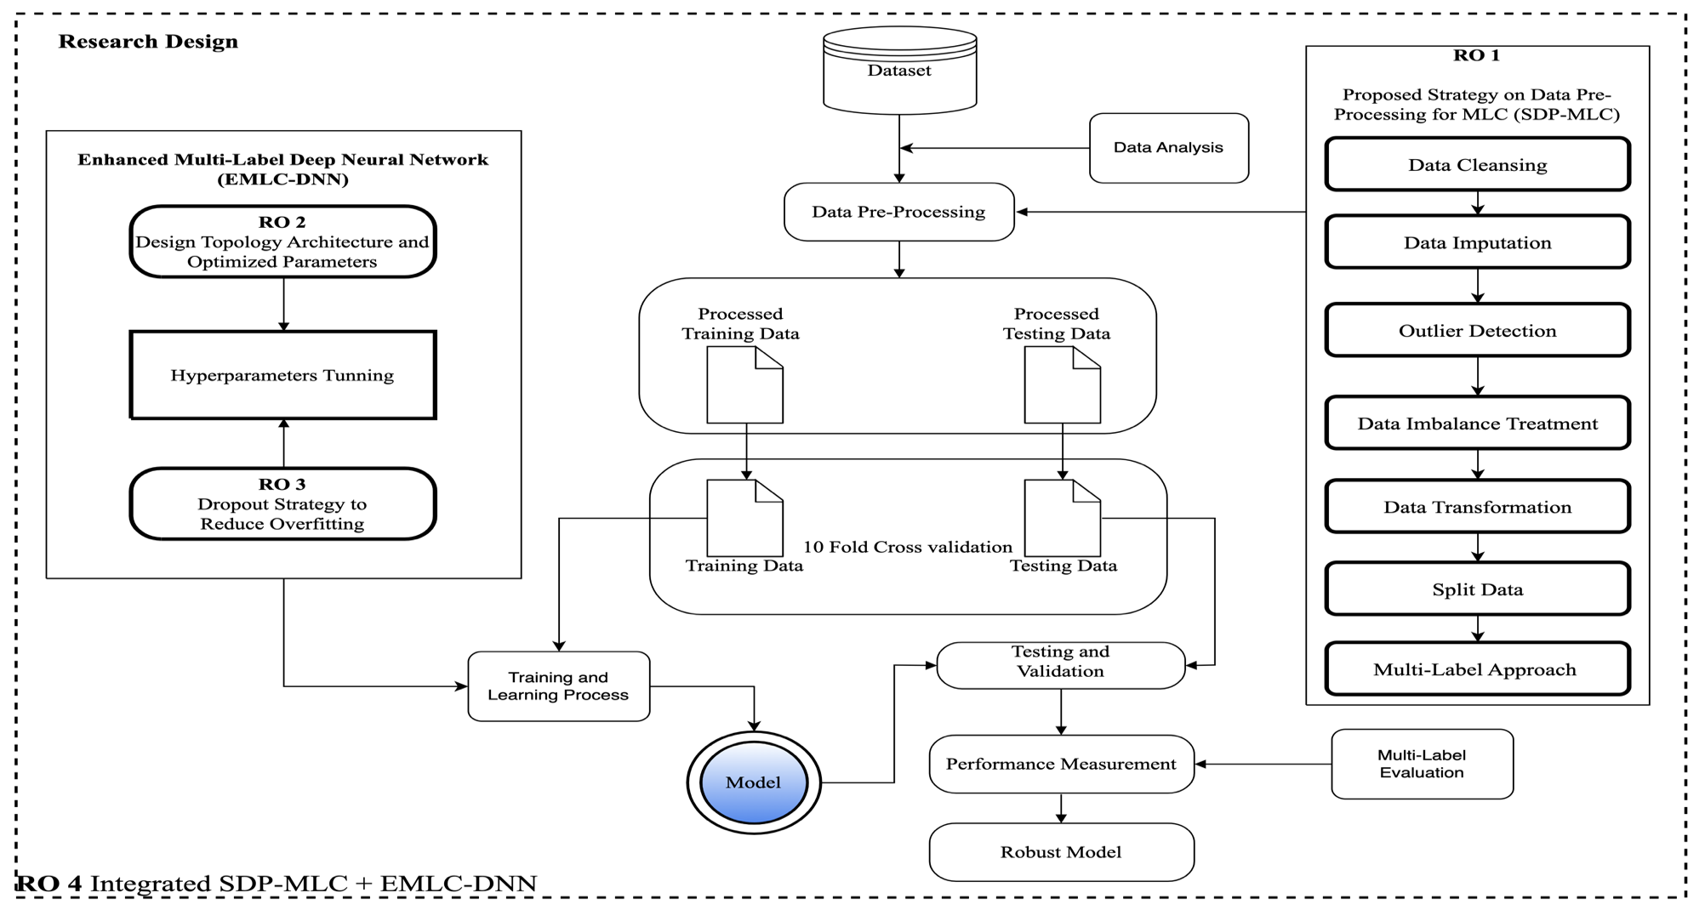

Slide 23
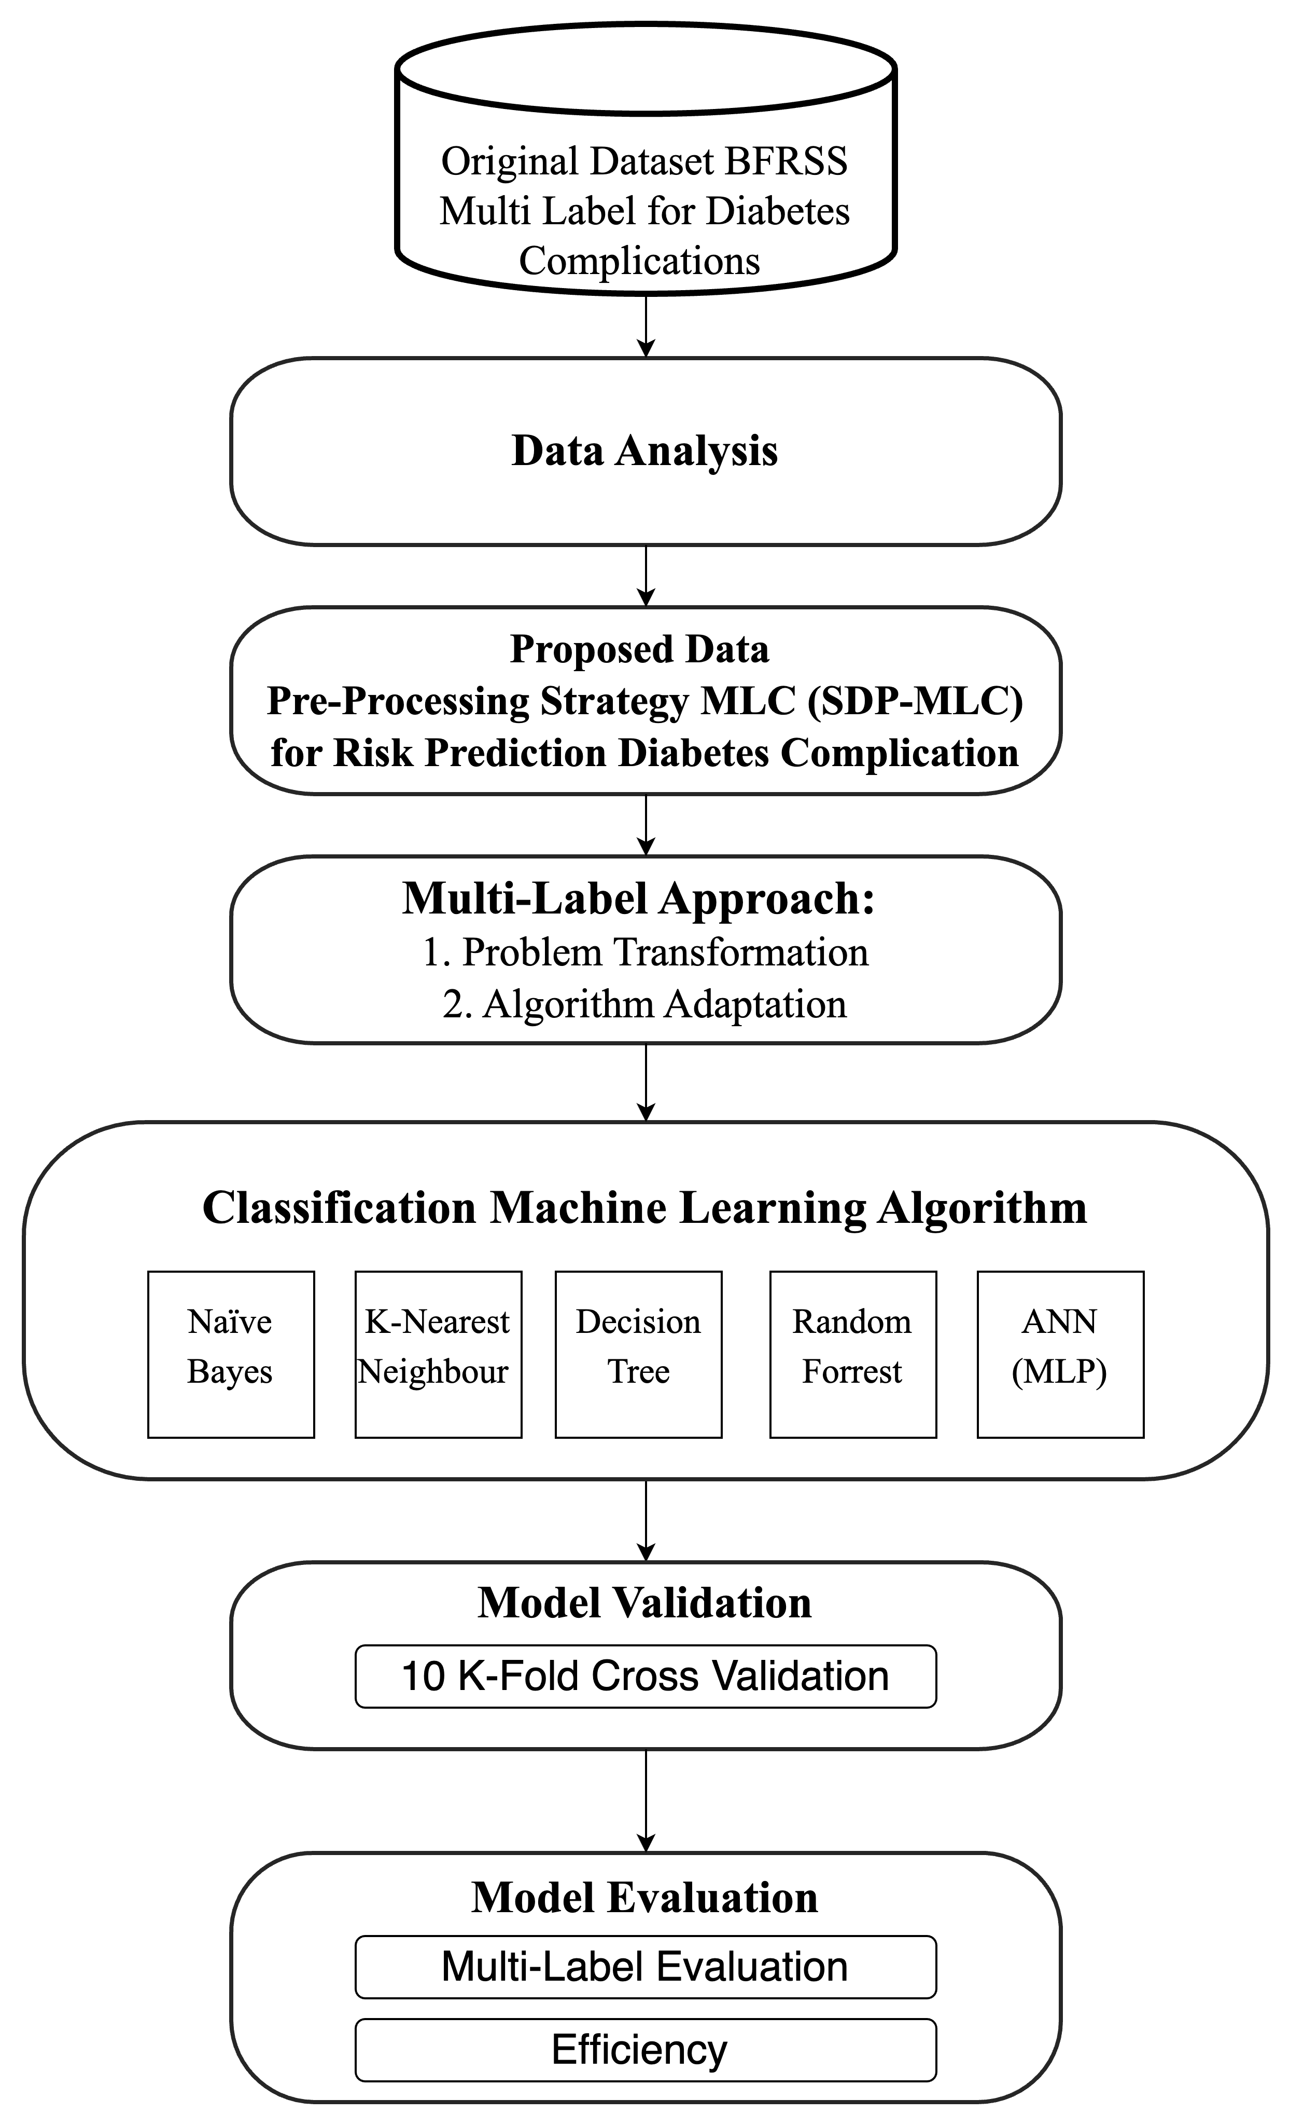
Methodology: Learning Framework 1

Slide 24
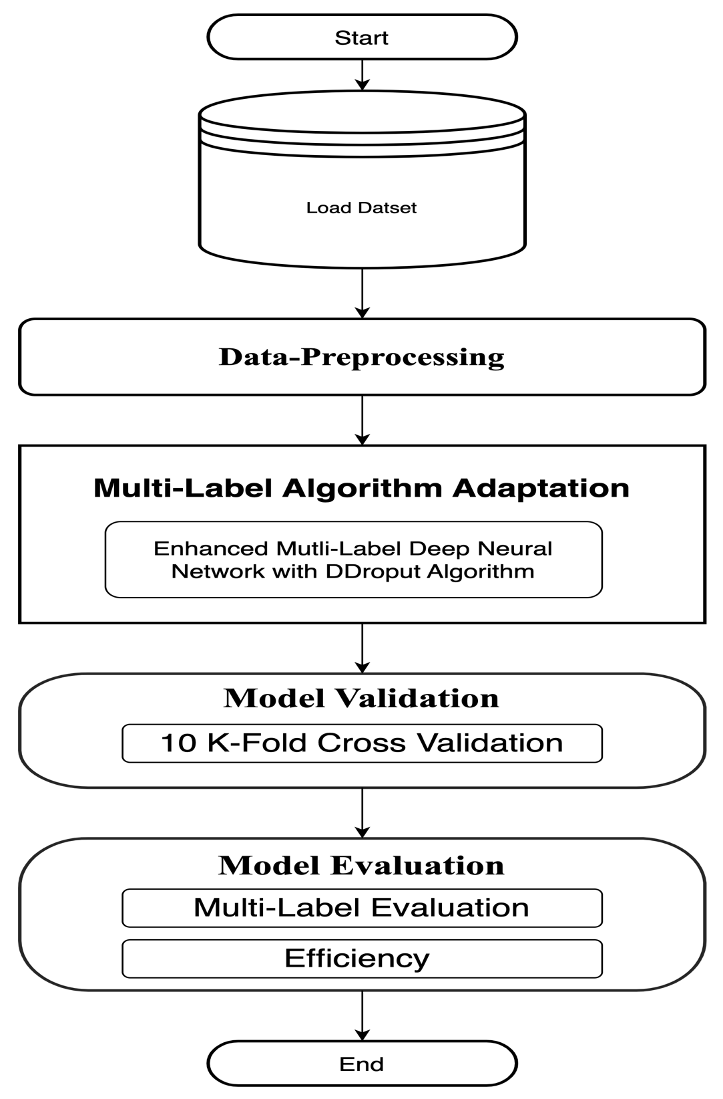
Methodology: Learning Framework 2

Slide 25
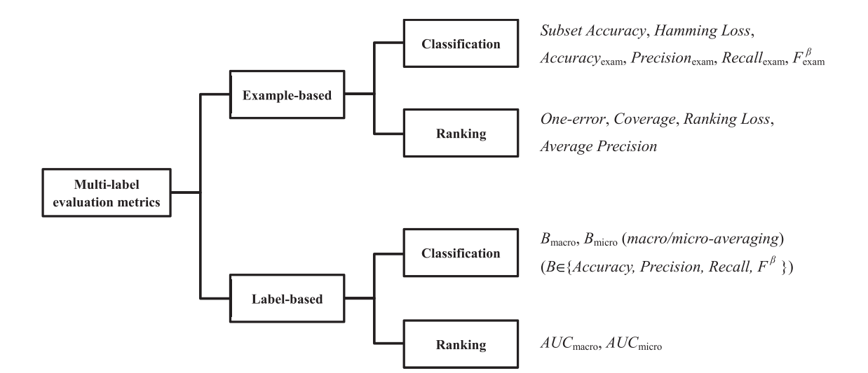
Evaluations For MLC

Slide 26
26

Slide 27

Data Analysis and Experimental Design

Slide 28
Experimental Settings
Notebook |  | Macbook Pro
Hardware | RAM | 16 GB
 | CPU | Apple M2 Processor (8-Core)
 | GPU | Apple M2 Processor (16-Core)
Software | OS | Mac OS Ventura
 | APPS | Python 3, Jupiter notebook and Visual Studio Code

Slide 29
Data Descriptions

Slide 30
Data Preparation on BFRSS
No | Year | Total Variable | Variable Used | Total Row
1 | 2016 | 275 | 33 | 486.303
2 | 2017 | 358 | 33 | 450.016
3 | 2018 | 275 | 33 | 437.436
4 | 2019 | 342 | 33 | 418.268
5 | 2020 | 279 | 33 | 401.958
6 | 2021 | 303 | 33 | 438.693
Total |  |  |  | 2.632.674

Slide 31
Methodology: Learning Framework 1

Slide 32
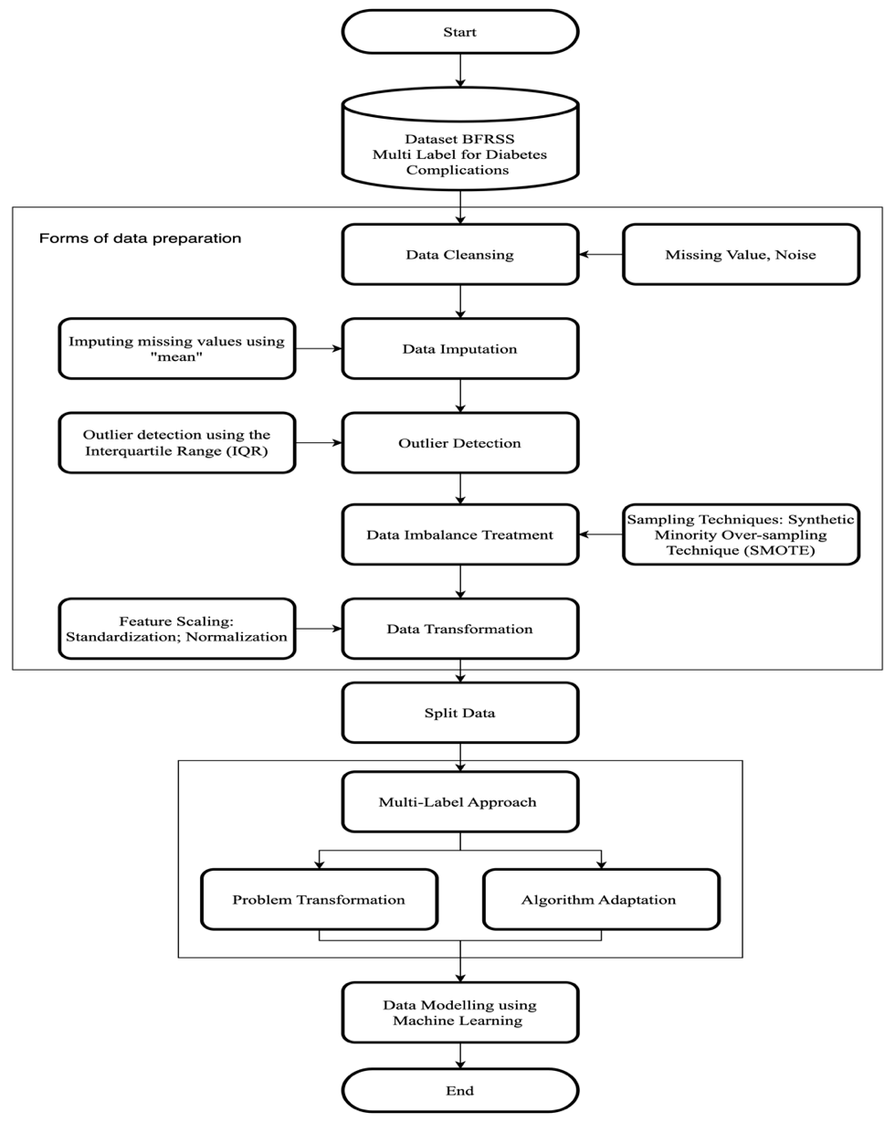
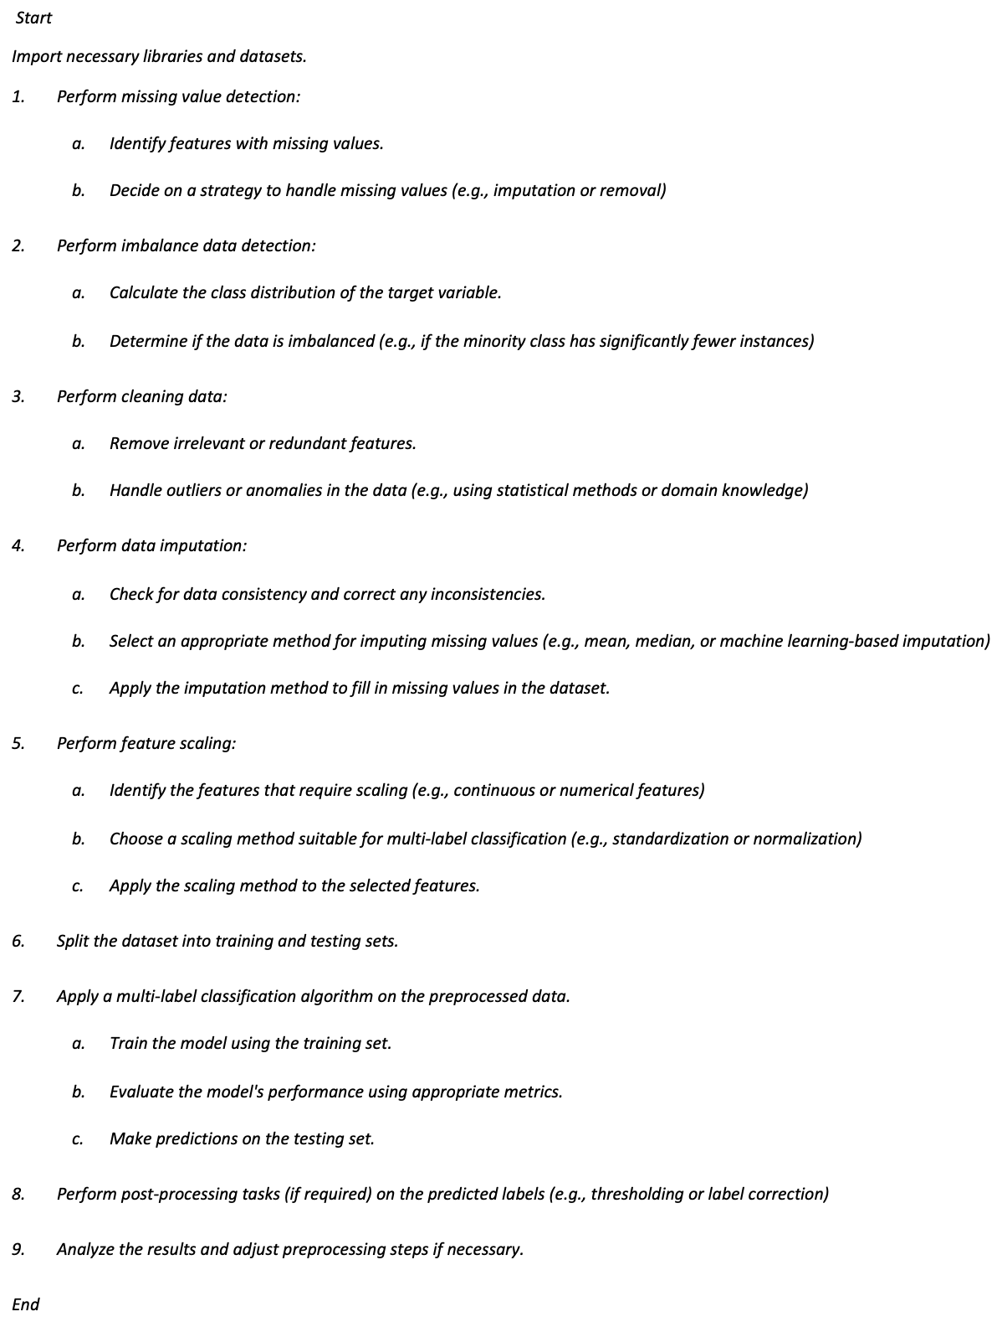
RO 1: Enhanced Data-preprocessing

Slide 33
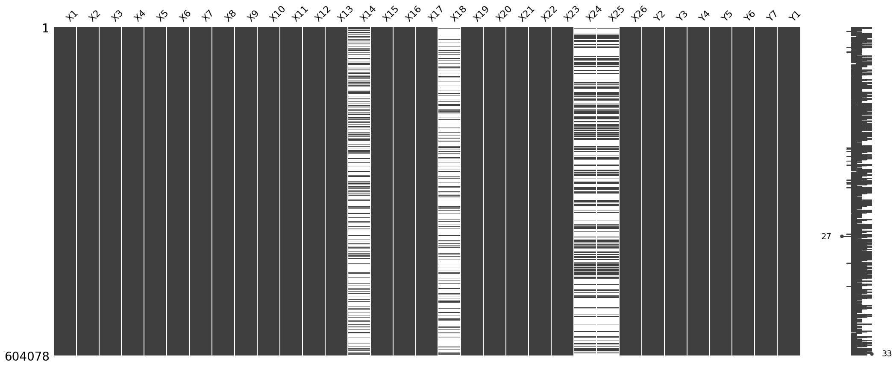
Data Problem with Null or NAN /Missing Value

Slide 34
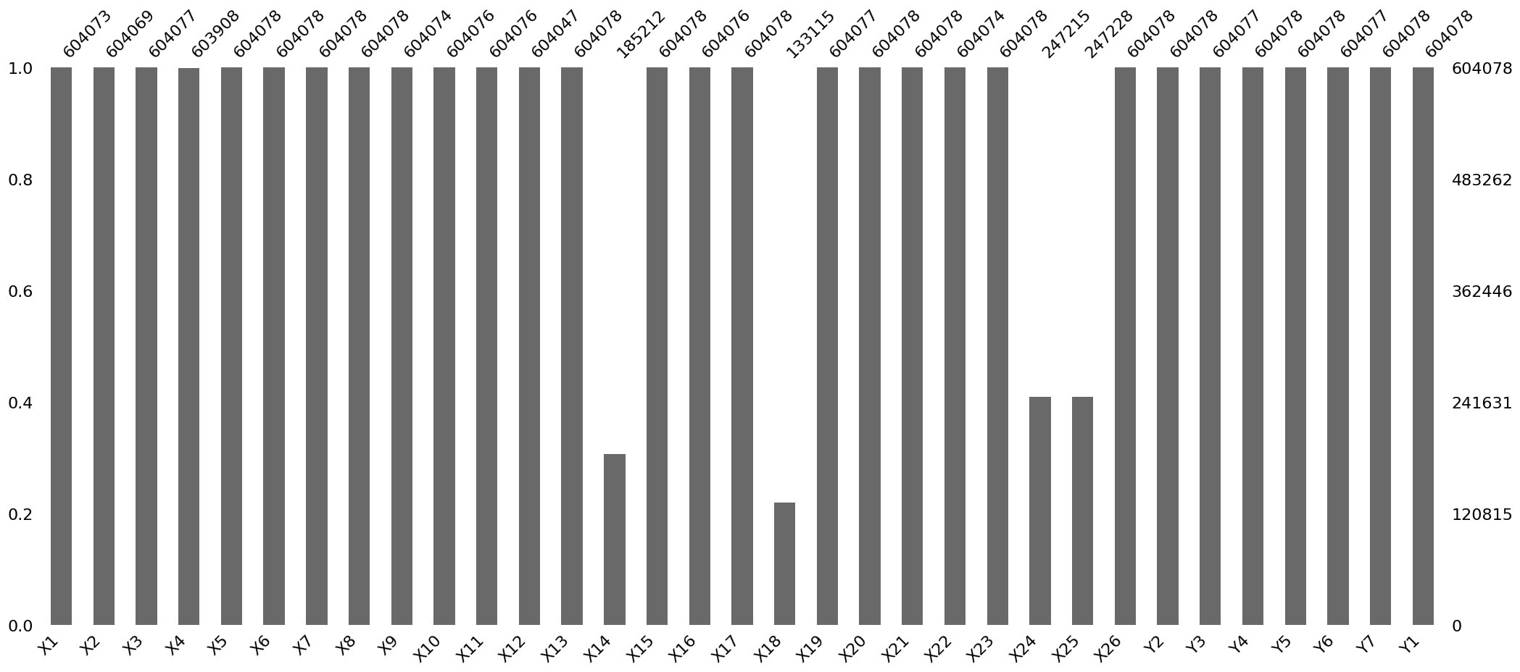
Data Problem with Null or NAN /Missing Value

Slide 35
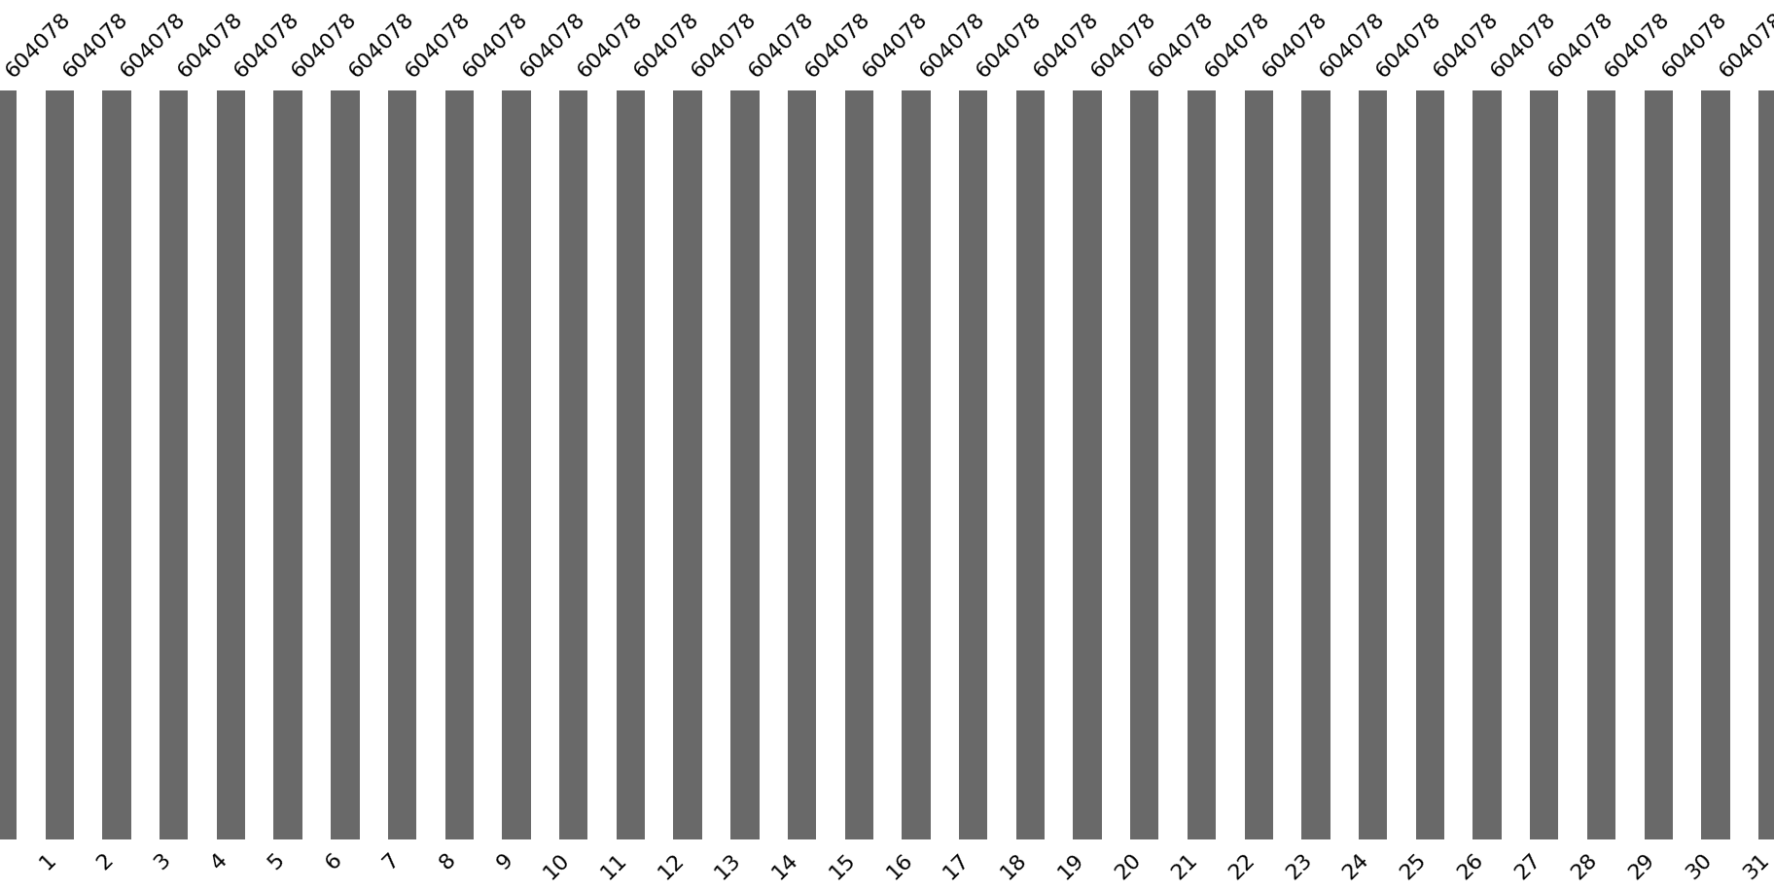
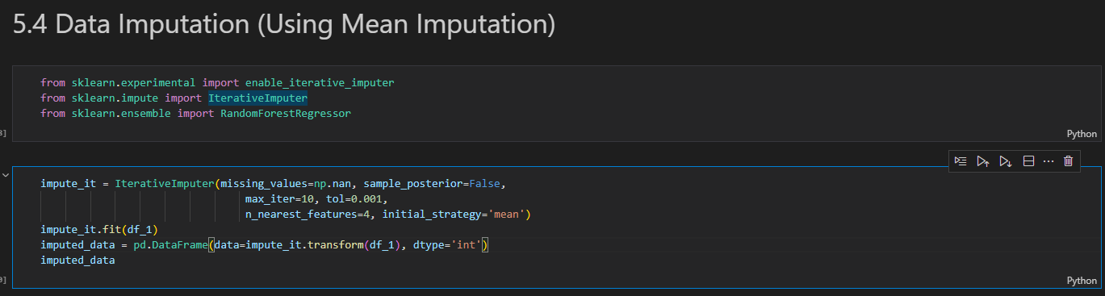
Data Imputation

Slide 36
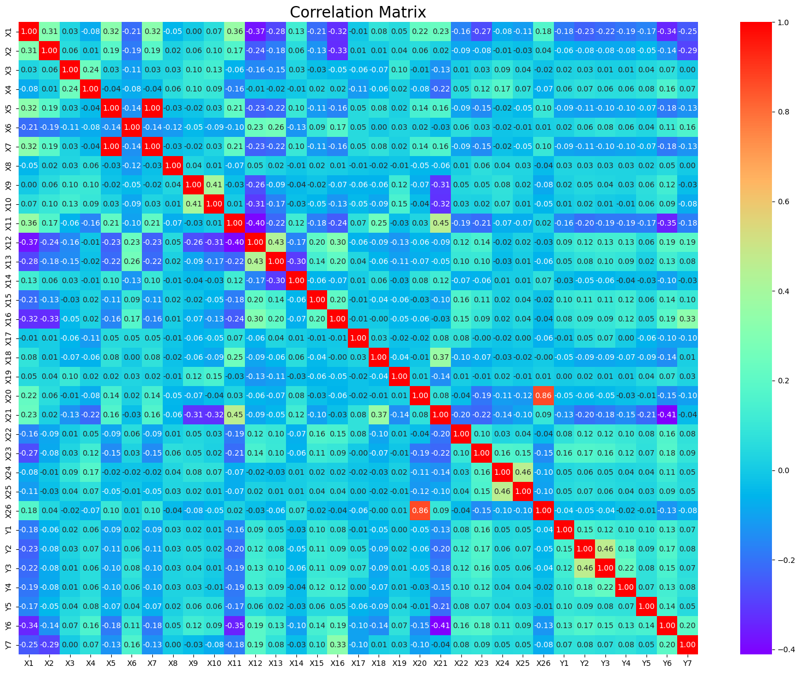
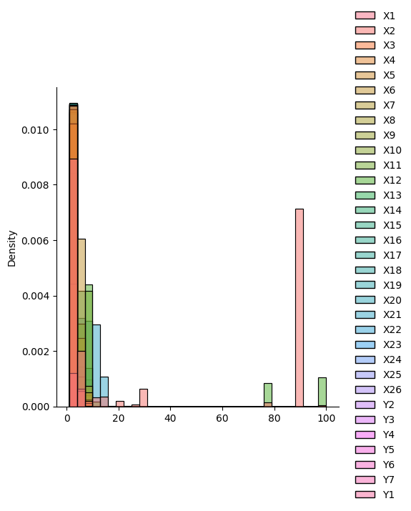
Data Analysis after imputation

Slide 37
Example Result of Input Output on Dataset
No | X1 | X2 | X3 | X4 | X5 | X6 | X7 | X8 | X9 | X10 | X11 | X12 | X13 | X14 | X15 | X16 | X17 | X18 | X19 | X20 | X21 | X22 | X23 | X24 | X25 | X26 | Y1 | Y2 | Y3 | Y4 | Y5 | Y6 | Y7
1 | 3 | 1 | 1 | 1 | 1 | 1 | 1 | 1 | 3 | 1 | 7 | 7 | 3 | 2 | 2 | 2 | 2 | 1 | 1 | 2 | 3 | 2 | 3 | 1 | 3 | 1 | 2 | 2 | 1 | 2 | 2 | 1 | 2
2 | 5 | 3 | 1 | 1 | 2 | 4 | 2 | 1 | 5 | 1 | 8 | 1 | 1 | 1 | 1 | 1 | 2 | 1 | 3 | 4 | 2 | 2 | 1 | 1 | 2 | 2 | 2 | 2 | 2 | 2 | 2 | 1 | 1
3 | 4 | 1 | 1 | 1 | 2 | 1 | 2 | 2 | 2 | 2 | 5 | 1 | 1 | 3 | 2 | 2 | 2 | 1 | 1 | 2 | 1 | 2 | 3 | 2 | 3 | 1 | 2 | 2 | 2 | 2 | 2 | 2 | 1
4 | 4 | 1 | 1 | 1 | 2 | 4 | 2 | 1 | 1 | 1 | 7 | 4 | 2 | 5 | 2 | 1 | 1 | 2 | 1 | 4 | 3 | 1 | 3 | 2 | 3 | 2 | 2 | 2 | 2 | 1 | 2 | 1 | 2
5 | 2 | 1 | 1 | 3 | 1 | 3 | 1 | 1 | 1 | 1 | 1 | 8 | 4 | 1 | 2 | 2 | 2 | 1 | 1 | 2 | 1 | 2 | 3 | 1 | 3 | 1 | 2 | 2 | 2 | 2 | 2 | 2 | 2
6 | 4 | 1 | 1 | 1 | 2 | 2 | 2 | 1 | 1 | 1 | 7 | 3 | 1 | 5 | 2 | 1 | 2 | 2 | 1 | 2 | 3 | 2 | 1 | 1 | 2 | 1 | 2 | 1 | 2 | 1 | 2 | 1 | 1

Slide 38
Obstacle on doing Experiment RO1
To much data are same instance because the null data was generated by impute techniques and make loss are high, the idea to handle this problems is removing similar data and identify the variance from the data.
There is some error while coding. Machine learning cannot run when embedded into Problem Transformation. Especially, Machine learning that we conduct for comparison performance.

Slide 39
Methodology: Learning Framework 2

Slide 40
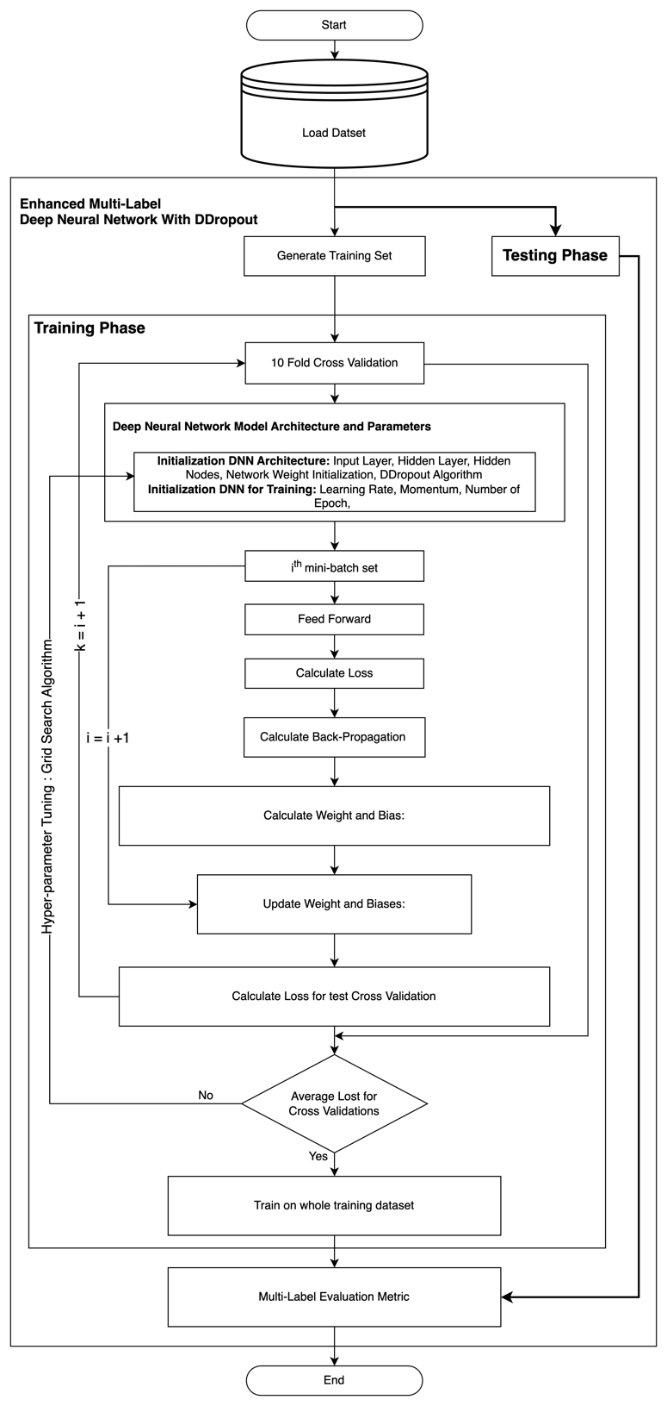
RO 2 and RO 3:
Proposed Model Multi Label Deep Neural Network with DDropout

Slide 41
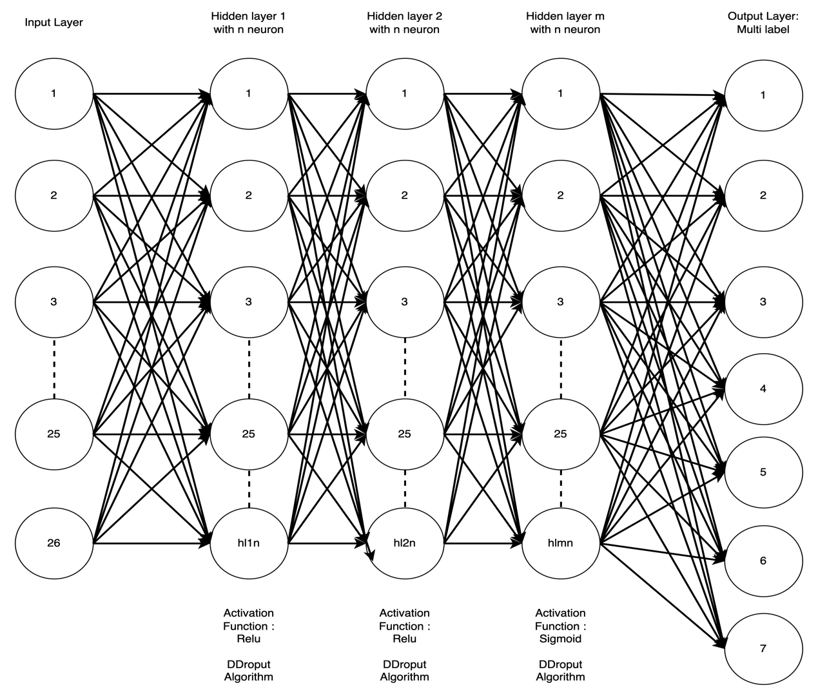
Proposed Architecture Multi Label Deep Neural Network with Dropout Strategy
Notes:
Standard DropOut can be applied to any hidden layer. It is to randomly select some neurons in the hidden layer to output to the next layer. As the image shows here, in the second hidden layer, we randomly select some neurons to output and disable other neurons during feedforward process. Then in back propagation process, we only update the weights connected to those selected neurons. We can also regard Dropout as Sampling training technique in training weight. In back propagation, since we randomly sample neurons to output, it can be regarded as a 0,1 mask to multiply the output in hidden layer. So in back propagation, the gradient to the weights of ignored neurons will be zeros.
Note that DropOut is applied in training step only. We DO NOT use dropout in prediction step as it can make the prediction unstable when randomly choosing different neurons for output.
DropOut Rate
DropOut rate is the possibility of training a given node in a hidden layer. If dropout rate is large, then it is more likely to select and train the node in hidden layer.
For example, if dropout rate = 0.1, then each node in a hidden layer has only 0.1 possibility of being trained (enabled to feedforward and back propagation) in training step. If dropout rate = 1, then all neurons in network will be trained.

Slide 42
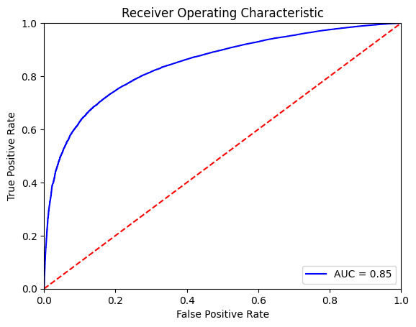
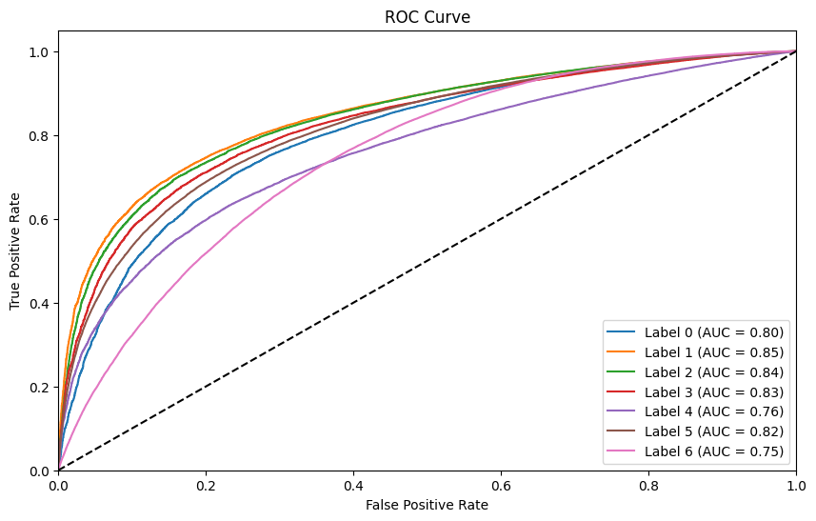
ROC MLC

Slide 43

Progress in this semester 12
Revised Chapter 2 by Finding Literature Review related approached with respect to MLC DNN and Dropout Techniques.
Writing Chapter 4, but still need result from experiment
Redesign methodology and learning framework
Redesign Proposed Model 1 (RQ 1) for strategy in Data-Preprocessing
Redesign Proposed Model 2 (RQ 2 and 3) for Enhancing MLC-AA-DNN with Dropout.
Preparing Data BRFFS for MLC and will be continue to train and Benchmark with Several ML Model and DNN in Multi-Label Approach

Slide 44
Conclusion
In this research, we aim to Enhanced Multi Label Deep neural network (DNN) model for Risk Prediction Diabetes Complication as follows:
This work has used Multi label Deep Neural Network (DNN) for diabetes prediction complication Based on behavior dataset as problem domain. The contribution of this research is trying to Enhanced Multi label Deep neural network (DNN) in order helping doctor to make a decision making for prevent patient develop diabetes complication based on public dataset not clinical data.
Enhanced Multi Label DNN by proposing Strategy Data-Pre-Processing MLC (EDPT) and designing Topology Architecture with Dropout Strategy (EDNN) in Classifications.
The contribution from this research is fulfill 2 domain area which is diabetic research or health and computer science (health informatic area).

Slide 45

Thank You

Slide 46
Problem Transformation

Slide 47
Problem Transformation-Binary Relevance (BR)
Experimental settings for PT-BR-CC-LP-CLR
MLC-BR-ML | Example Based Matric
 | SA | HL | A_{exp} | P_{exp} | R_{exp} | F1-S_{exp} | OE | C | RL | A_{p}
BR-NB
BR-K-NN
BR-DT
BR-RF
BR-ANN
MLC-BR-ML | Label Based Matric
 | Accuracy (micro) | Accuracy (macro) | Precision (micro) | Precision (macro) | Recall (micro) | Recall (macro) | F1-Score (micro) | F1-Score (macro) | AUC (micro) | AUC (macro)
BR-NB
BR-K-NN
BR-DT
BR-RF
BR-ANN
NB: Sub-set Accuracy; SA; Hamming Loss: HL; Accuracy_{exp}: A_{exp}; Precision_{exp}: P_{exp}; Recalle_{exp}: R_{exp};F1-Score_{exp}: F1-S_{exp}; One Error: OE; Covarage: C; Rangking Loss: RL; Average precision: A_{p}.
NB: Accuracy(micro): ;Accuracy(macro): ; Precision(micro): ;Precision(macro): ;Recall (micro): ; Recall (macro): ; F1-Score (micro): ; F1-Score (macro): ;AUC (micro): ; AUC (macro)

Slide 48
Problem Transformation-Classifier Chain (CC)
Experimental settings for PT-BR-CC-LP-CLR
MLC-CC-ML | Example Based Matric
 | SA | HL | A_{exp} | P_{exp} | R_{exp} | F1-S_{exp} | OE | C | RL | A_{p}
CC-NB
CC-K-NN
CC-DT
CC-RF
CC-ANN
MLC-CC-ML | Label Based Matric
 | Accuracy (micro) | Accuracy (macro) | Precision (micro) | Precision (macro) | Recall (micro) | Recall (macro) | F1-Score (micro) | F1-Score (macro) | AUC (micro) | AUC (macro)
CC-NB
CC-K-NN
CC-DT
CC-RF
CC-ANN
NB: Sub-set Accuracy; SA; Hamming Loss: HL; Accuracy_{exp}: A_{exp}; Precision_{exp}: P_{exp}; Recalle_{exp}: R_{exp};F1-Score_{exp}: F1-S_{exp}; One Error: OE; Covarage: C; Rangking Loss: RL; Average precision: A_{p}.
NB: Accuracy(micro): ;Accuracy(macro): ; Precision(micro): ;Precision(macro): ;Recall (micro): ; Recall (macro): ; F1-Score (micro): ; F1-Score (macro): ;AUC (micro): ; AUC (macro)

Slide 49
Problem Transformation-Label Powerset (LP)
Experimental settings for PT-BR-CC-LP-CLR
MLC-LP-ML | Example Based Matric
 | SA | HL | A_{exp} | P_{exp} | R_{exp} | F1-S_{exp} | OE | C | RL | A_{p}
LP-NB
LP-K-NN
LP-DT
LP-RF
LP-ANN
MLC-LP-ML | Label Based Matric
 | Accuracy (micro) | Accuracy (macro) | Precision (micro) | Precision (macro) | Recall (micro) | Recall (macro) | F1-Score (micro) | F1-Score (macro) | AUC (micro) | AUC (macro)
LP-NB
LP-K-NN
LP-DT
LP-RF
LP-ANN
NB: Sub-set Accuracy; SA; Hamming Loss: HL; Accuracy_{exp}: A_{exp}; Precision_{exp}: P_{exp}; Recalle_{exp}: R_{exp};F1-Score_{exp}: F1-S_{exp}; One Error: OE; Covarage: C; Rangking Loss: RL; Average precision: A_{p}.
NB: Accuracy(micro): ;Accuracy(macro): ; Precision(micro): ;Precision(macro): ;Recall (micro): ; Recall (macro): ; F1-Score (micro): ; F1-Score (macro): ;AUC (micro): ; AUC (macro)

Slide 50
Problem Transformation-Calibrated Label Ranking (CLR)
Experimental settings for PT-BR-CC-LP-CLR
MLC-CLR-ML | Example Based Matric
 | SA | HL | A_{exp} | P_{exp} | R_{exp} | F1-S_{exp} | OE | C | RL | A_{p}
CLR-NB
CLR-K-NN
CLR-DT
CLR-RF
CLR-ANN
MLC-CLR-ML | Label Based Matric
 | Accuracy (micro) | Accuracy (macro) | Precision (micro) | Precision (macro) | Recall (micro) | Recall (macro) | F1-Score (micro) | F1-Score (macro) | AUC (micro) | AUC (macro)
CLR-NB
CLR-K-NN
CLR-DT
CLR-RF
CLR-ANN
NB: Sub-set Accuracy; SA; Hamming Loss: HL; Accuracy_{exp}: A_{exp}; Precision_{exp}: P_{exp}; Recalle_{exp}: R_{exp};F1-Score_{exp}: F1-S_{exp}; One Error: OE; Covarage: C; Rangking Loss: RL; Average precision: A_{p}.
NB: Accuracy(micro): ;Accuracy(macro): ; Precision(micro): ;Precision(macro): ;Recall (micro): ; Recall (macro): ; F1-Score (micro): ; F1-Score (macro): ;AUC (micro): ; AUC (macro)

Slide 51
Algorithm Adaptation (AA)
Experimental settings for AA
MLC-AA-ML | Example Based Matric
 | SA | HL | A_{exp} | P_{exp} | R_{exp} | F1-S_{exp} | OE | C | RL | A_{p}
AA-NB
AA-K-NN
AA-DT
AA-RF
AA-ANN
MLC-AA-ML | Label Based Matric
 | Accuracy (micro) | Accuracy (macro) | Precision (micro) | Precision (macro) | Recall (micro) | Recall (macro) | F1-Score (micro) | F1-Score (macro) | AUC (micro) | AUC (macro)
AA-NB
AA-K-NN
AA-DT
AA-RF
AA-ANN
NB: Sub-set Accuracy; SA; Hamming Loss: HL; Accuracy_{exp}: A_{exp}; Precision_{exp}: P_{exp}; Recalle_{exp}: R_{exp};F1-Score_{exp}: F1-S_{exp}; One Error: OE; Covarage: C; Rangking Loss: RL; Average precision: A_{p}.
NB: Accuracy(micro): ;Accuracy(macro): ; Precision(micro): ;Precision(macro): ;Recall (micro): ; Recall (macro): ; F1-Score (micro): ; F1-Score (macro): ;AUC (micro): ; AUC (macro)

Slide 52
Algorithm Adaptation

Slide 53
MLC | Example Based Matric
 | SA | HL | A_{exp} | P_{exp} | R_{exp} | F1-S_{exp} | OE | C | RL | A_{p}
BR-DDN with Ddropout (Proposed Model)
CC-AA-DDN with Ddropout (Proposed Model)
LP-AA-DDN with Ddropout (Proposed Model)
CLR-AA-DDN with Ddropout (Proposed Model)
AA-DDN with Ddropout (Proposed Model)
MLC | Label Based Matric
 | Accuracy (micro) | Accuracy (macro) | Precision (micro) | Precision (macro) | Recall (micro) | Recall (macro) | F1-Score (micro) | F1-Score (macro) | AUC (micro) | AUC (macro)
BR-DDN with Ddropout (Proposed Model)
CC-AA-DDN with Ddropout (Proposed Model)
LP-AA-DDN with Ddropout (Proposed Model)
CLR-AA-DDN with Ddropout (Proposed Model)
AA-DDN with Ddropout (Proposed Model)
NB: Sub-set Accuracy; SA; Hamming Loss: HL; Accuracy_{exp}: A_{exp}; Precision_{exp}: P_{exp}; Recalle_{exp}: R_{exp};F1-Score_{exp}: F1-S_{exp}; One Error: OE; Covarage: C; Rangking Loss: RL; Average precision: A_{p}.
NB: Accuracy(micro): ;Accuracy(macro): ; Precision(micro): ;Precision(macro): ;Recall (micro): ; Recall (macro): ; F1-Score (micro): ; F1-Score (macro): ;AUC (micro): ; AUC (macro)

Slide 54
References
[1] R. R. Wing et al., “Behavioral science research in diabetes: lifestyle changes related to obesity, eating behavior, and physical activity.,” Diabetes Care, vol. 24, no. 1, pp. 117–23, 2001.
[2] A. B. Olokoba, O. A. Obateru, and L. B. Olokoba, “Type 2 diabetes mellitus: A review of current trends,” Oman Med. J., vol. 27, no. 4, pp. 269–273, 2012.
[3] American Diabetes Association., “Diagnosis and classification of diabetes mellitus,” Diabetes Care, vol. 37, no. SUPPL.1, pp. 81–90, 2014.
[4] C. Wang et al., “Evaluating the risk of type 2 diabetes mellitus using artificial neural network: An effective classification approach,” Diabetes Res. Clin. Pract., vol. 100, no. 1, pp. 111–118, 2013.
[5] O. Erkaymaz, M. Ozer, and M. Perc, “Performance of small-world feedforward neural networks for the diagnosis of diabetes,” Appl. Math. Comput., vol. 311, pp. 22– 28, Oct. 2017.
[6] I. Kavakiotis, O. Tsave, A. Salifoglou, N. Maglaveras, I. Vlahavas, and I. Chouvarda, “Machine Learning and Data Mining Methods in Diabetes Research,” Comput. Struct. Biotechnol. J., vol. 15, pp. 104–116, 2017.
[7] R. Kagawa et al., “Development of Type 2 Diabetes Mellitus Phenotyping Framework Using Expert Knowledge and Machine Learning Approach,” J. Diabetes Sci. Technol., vol. 11, no. 4, pp. 791–799, Jul. 2017.
[8] P. Z. Zimmet, D. J. Magliano, W. H. Herman, and J. E. Shaw, “Diabetes: A 21st century challenge,” Lancet Diabetes Endocrinol., vol. 2, no. 1, pp. 56–64, 2014.
[9] L. Mihardja, U. Soetrisno, and S. Soegondo, “Prevalence and clinical profile of diabetes mellitus in productive aged urban Indonesians,” J. Diabetes Investig., vol. 5, no. 5, pp. 507–512, 2014.
[10] K. Ogurtsova et al., “IDF Diabetes Atlas: Global estimates for the prevalence of diabetes for 2015 and 2040,”Diabetes Res. Clin. Pract., vol. 128, pp. 40–50, Jun. 2017.
[11] M. J. Fowler, “Microvascular and Macrovascular Complications of Diabetes,” Clin. Diabetes, vol. 26, no. 2, pp. 77– 82, 2008.
[12] A. Kalantari, A. Kamsin, S. Shamshirband, A. Gani, H. Alinejad-Rokny, and A. T. Chronopoulos, “Computational intelligence approaches for classification of medical data: State-of-the-art, future challenges and research directions,” Neurocomputing, vol. 276, pp. 2–22, Feb. 2018.
[13] A. E. W. Johnson, M. M. Ghassemi, S. Nemati, K. E. Niehaus, D. Clifton, and G. D. Clifford, “Machine Learning and Decision Support in Critical Care,” Proc. IEEE, vol. 104, no. 2, pp. 444–466, Feb. 2016.
[14] K. Zarkogianni et al., “A Review of Emerging Technologies for the Management of Diabetes Mellitus,” IEEE Trans. Biomed. Eng., vol. 62, no. 12, pp. 2735–2749, 2015.
[15] N. Jayanthi, B. V. Babu, and N. S. Rao, “Survey on clinical prediction models for diabetes prediction,” J. Big Data, vol. 4, no. 1, 2017.
[16] M. Marinov, A. S. M. Mosa, I. Yoo, and S. A. Boren, “Data-Mining Technologies for Diabetes: A Systematic Review,” J. Diabetes Sci. Technol., vol. 5, no. 6, pp. 1549– 1556, Nov. 2011.
[17] A. Dagliati et al., “Machine Learning Methods to Predict Diabetes Complications,” J. Diabetes Sci. Technol., vol. 12, no. 2, pp. 295–302, Mar. 2018.
[18] S. Ramírez-Gallego, B. Krawczyk, S. García, M. Woźniak, and F. Herrera, “A survey on data preprocessing for data stream mining: Current status and future directions,” Neurocomputing, vol. 239, pp. 39–57, 2017.
[19] K. V. S. R. P. Varma, A. A. Rao, T. Sita Maha Lakshmi, and P. V. Nageswara Rao, “A computational intelligence approach for a better diagnosis of diabetic patients,” Comput. Electr. Eng., vol. 40, no. 5, pp. 1758–1765, 2014.
[20] S. Pachange, B. Joglekar, and P. Kulkarni, “An ensemble classifier approach for disease diagnosis using Random Forest,” in 2015 Annual IEEE India Conference (INDICON), 2015, pp. 1–5.

Slide 55
References
[21] V. Lagani, L. Koumakis, F. Chiarugi, E. Lakasing, and I. Tsamardinos, “A systematic review of predictive risk models for diabetes complications based on large scale clinical studies,” J. Diabetes Complications, vol. 27, no. 4, pp. 407–413, 2013.
[22] V. Lagani et al., “Development and validation of risk assessment models for diabetes-related complications based on the DCCT/EDIC data,” J. Diabetes Complications, vol. 29, no. 4, pp. 479–487, 2015.
[23] N. Esfandiari, M. R. Babavalian, A. M. E. Moghadam, and V. K. Tabar, “Knowledge discovery in medicine: Current issue and future trend,” Expert Syst. Appl., vol. 41, no. 9, pp. 4434–4463, 2014.
[24] K. Papatheodorou, M. Banach, M. Edmonds, N. Papanas, and D. Papazoglou, “Complications of Diabetes,” J. Diabetes Res., vol. 2015, pp. 1–5, 2015.
[25] K. Papatheodorou, M. Banach, E. Bekiari, M. Rizzo, and M. Edmonds, “Complications of Diabetes 2017,” J. Diabetes Res., vol. 2018, pp. 1–4, 2018.
[26] Z. Tao, A. Shi, and J. Zhao, “Epidemiological Perspectives of Diabetes,” Cell Biochem. Biophys., vol. 73, no. 1, pp. 181–185, 2015.
[27] American Diabetes Association, “2. Classification and diagnosis of diabetes,” Diabetes Care, vol. 39, no. January, pp. S13–S22, 2016.
[28] A. Ramezankhani, E. Hadavandi, O. Pournik, J. Shahrabi, F. Azizi, and F. Hadaegh, “Decision tree-based modelling for identification of potential interactions between type 2 diabetes risk factors: a decade follow-up in a Middle East prospective cohort study,” BMJ Open, vol. 6, no. 12, p. e013336, Dec. 2016.
[29] S. Batra and S. Sachdeva, “Organizing standardized electronic healthcare records data for mining,” Heal. Policy Technol., vol. 5, no. 3, pp. 226–242, Sep. 2016.
[30] M. Sudha, “Evolutionary and Neural Computing Based Decision Support System for Disease Diagnosis from Clinical Data Sets in Medical Practice,” J. Med. Syst., vol. 41, no. 11, 2017.
[31] J. Yang, F. Zhang, X. Jiang, X. Shen, and X. Hu, “Classify and identify the risky loci of type 2 diabetes with computational method,” in 2017 IEEE International Conference on Bioinformatics and Biomedicine (BIBM), 2017, vol. 2017–Janua, pp. 1331–1337.
[32] N. A. Vignesh and D. I. G. Amalarethinam, “Rule Extraction for Diagnosis of Diabetes Mellitus Used for Enhancing Regular Covering Technique,” in 2017 World Congress on Computing and Communication Technologies (WCCCT), 2017, pp. 111–114.
[33] V. Potenciano, M. M. Abad-Grau, A. Alcina, and F. Matesanz, “A comparison of genomic profiles of complex diseases under different models,” BMC Med. Genomics, vol. 9, no. 1, pp. 1–16, 2016.
[34] C. Sinoquet, “A method combining a random forest-based technique with the modeling of linkage disequilibrium through latent variables, to run multilocus genome-wide association studies,” BMC Bioinformatics, vol. 19, no. 1, pp. 1–24, 2018.
[35] S. Poonkuzhali, J. Jeyalakshmi, and S. Sreesubha, “Diabetes Mellitus Risk Factor Prediction Through Resampling and Cost Analysis on Classifiers,” vol. 836, Springer Singapore, 2018, pp. 212–225.

Slide 56
References
[36] A. Pimentel, A. V. Carreiro, R. T. Ribeiro, and H. Gamboa, “Screening diabetes mellitus 2 based on electronic health records using temporal features,” Health Informatics J., vol. 24, no. 2, pp. 194–205, Jun. 2018.
[37] X. Huang, Q.-S. Xu, Y.-H. Yun, J.-H. Huang, and Y.-Z. Liang, “Weighted variable kernel support vector machine classifier for metabolomics data analysis,” Chemom. Intell. Lab. Syst., vol. 146, pp. 365–370, Aug. 2015.
[38] M. Heydari, M. Teimouri, Z. Heshmati, and S. M. Alavinia, “Comparison of various classification algorithms in the diagnosis of type 2 diabetes in Iran,” Int. J. Diabetes Dev. Ctries., vol. 36, no. 2, pp. 167–173, Jun. 2016.
[39] R. Ali, M. H. Siddiqi, M. Idris, B. H. Kang, and S. Lee, “Prediction of Diabetes Mellitus Based on Boosting Ensemble Modeling,” in Ubiquitous Computing and Ambient Intelligence. Personalisation and User Adapted Services, vol. 8867, 2014, pp. 25–28.
[40] U. R. Acharya et al., “An integrated diabetic index using heart rate variability signal features for diagnosis of diabetes,” Comput. Methods Biomech. Biomed. Engin., vol. 16, no. 2, pp. 222–234, Feb. 2013.
[41] G. Acciaroli et al., “Diabetes and Prediabetes Classification Using Glycemic Variability Indices From Continuous Glucose Monitoring Data,” J. Diabetes Sci. Technol., vol. 12, no. 1, pp. 105–113, Jan. 2018.
[42] T. Conca et al., “Multidisciplinary Collaboration in the Treatment of Patients With Type 2 Diabetes in Primary Care: Analysis Using Process Mining,” J. Med. Internet Res., vol. 20, no. 4, p. e127, Apr. 2018.
[43] H. Esmaily, M. Tayefi, H. Doosti, M. Ghayour-Mobarhan, H. Nezami, and A. Amirabadizadeh, “A Comparison between Decision Tree and Random Forest in Determining the Risk Factors Associated with Type 2 Diabetes.,” J. Res. Health Sci., vol. 18, no. 2, p. e00412, Apr. 2018.
[44] J. Debédat et al., “Long-term Relapse of Type 2 Diabetes After Roux-en-Y Gastric Bypass: Prediction and Clinical Relevance,” Diabetes Care, vol. 41, no. 10, pp. 2086–2095, Oct. 2018.
[45] S. Basu, S. Raghavan, D. J. Wexler, and S. A. Berkowitz, “Characteristics Associated With Decreased or Increased Mortality Risk From Glycemic Therapy Among Patients With Type 2 Diabetes and High Cardiovascular Risk: Machine Learning Analysis of the ACCORD Trial,” Diabetes Care, vol. 41, no. 3, pp. 604–612, Mar. 2018.
[46] Uci machine learning repository. available at http://archive.ics.uci.edu/ml/; 2018 [Online]
[47] Xie, Z. et al. (2019) ‘Building risk prediction models for type 2 diabetes using machine learning techniques’, Preventing Chronic Disease, 16(9), pp. 1–9. doi: 10.5888/pcd16.190109.

Slide 57
There are several ways to improve Dropout in deep neural networks:
Use higher Dropout rate: A higher Dropout rate can lead to better generalization, but it also increases the chance of under-fitting.
Increase the size of the model: A larger model can benefit from Dropout as it reduces over-fitting.
Use other regularization techniques: Dropout can be combined with other regularization techniques such as L1, L2 regularization, or early stopping to improve its performance.
Adaptive Dropout: Adaptive Dropout adjusts the Dropout rate during training based on the validation loss, to find the optimal rate.
Use DropConnect: DropConnect is a variant of Dropout, where connections between neurons are randomly dropped instead of neurons themselves.
Use Monte Carlo Dropout: Monte Carlo Dropout involves using Dropout at test time and can be combined with ensembling to produce a better prediction.
Experiment with different architectures: Different architectures can benefit from Dropout in different ways. Try different architectures to find the best one for your problem.

